Slide 1
Software Requirements Specification Document
Gain a deeper understanding of the Software Requirement Specification phase and the Software Requirement Specification (SRS). Learn how to write requirements and specifications.
Course: Software Construction
Prepared and Presented By: Engr. HAMZA

Slide 2

Objectives:
Understand the fundamental purpose and significance of the Software Requirement Specification (SRS) phase in software development.
Learn the key components and structure of a well-defined SRS document.
Gain knowledge of the characteristics that define a "Perfect SRS" and how they contribute to successful software development.
Acquire the skills to write clear, concise, and unambiguous software requirements.
Master the art of creating complete SRS documents without any sections left as "To Be Determined (TBD)."
Develop the ability to formulate verifiable requirements that can be tested and validated.
Ensure consistency in terminology and behavior across software requirements.
Enhance the capability to create software specifications that are understandable and usable by both technical teams and customers.
Understand how to make SRS documents modifiable to accommodate future changes and updates.
Gain proficiency in creating SRS documents that are design-independent and adaptable to various design implementations.
Learn to write requirements and specifications in a concise manner, avoiding unnecessary technical jargon.

Slide 3

What is requirement: A requirement is a statement of a behavior or attribute that a system must possess for the system to be acceptable to a stakeholder. What is a Software Requirements Specification (SRS)? An SRS document is a document that describes the requirements of a computer system from the user's point of view. What does an SRS Document Specify? The required behavior of a system in terms of: input data, required processing, output data, operational scenarios and interfaces. The attributes of a system including performance, security, maintainability, reliability, availability, safety requirements and design constraints.

Slide 4

What is Requirements Management?
Requirements management is a systematic approach to eliciting, organizing and documenting the requirements of a system.
It is a process that establishes and maintains agreement between the customer and the project team on the changing requirements of a system.
Why is Requirements Management Important?
By organizing and tracking the requirements and managing the requirement changes, you improve the chances of completing the project on time and under budget.
Poor change management is a key cause of project failure.

Slide 5
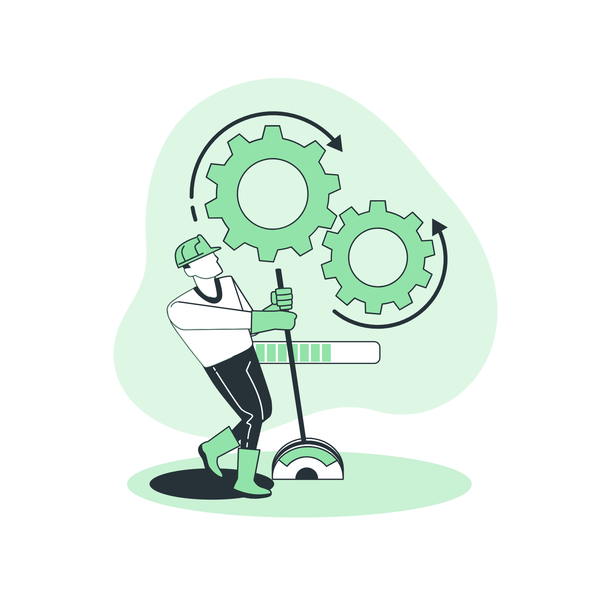
2.1 Requirements engineering process
Requirements engineering process consists of four phases:
Requirements elicitation: getting the customers to state exactly what the requirements are.
Requirements analysis: making qualitative judgments and checking for consistency and feasibility of requirements.
Requirements validation: demonstrating that the requirements define the system that the customer really wants.
Requirements management: the process of managing changing requirements during the requirements engineering process and system development, and identifying missing and extra requirements.

Slide 6
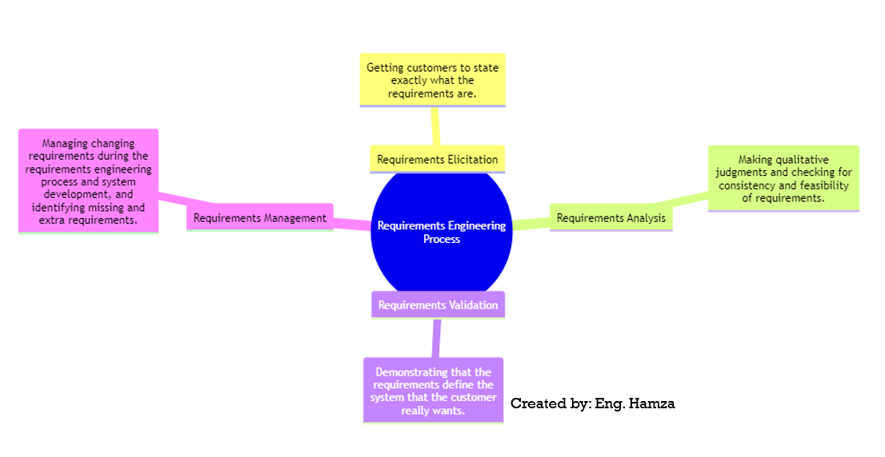
Mindmap:

Slide 7
2.2 Writing Requirements
Requirements must always be:
Correct
Unambiguous
Complete
Consistent
Testable

Slide 8
2.2.1 Recommendations When Writing Requirements
Never assume others understand what you mean.
Use meaningful words; avoid vague terms like process, manage, perform, handle, and support.
State requirements, not features.
Avoid conjunctions and conditionals.
Avoid using possibilities (may, might, probably, usually).

Slide 9
2.3 Writing Specifications
Specifications describe the operations and attributes of a system. They differ from requirements as they:
Are sufficiently complete and free from conflicts.
Describe the system as it will be built and resolve conflicting requirements.
Specifications are essential unless:
You're using an incremental development process.
You're working on research or proof-of-concept projects.
You're building very small projects.
It's not more cost-effective or faster than building the product.

Slide 10
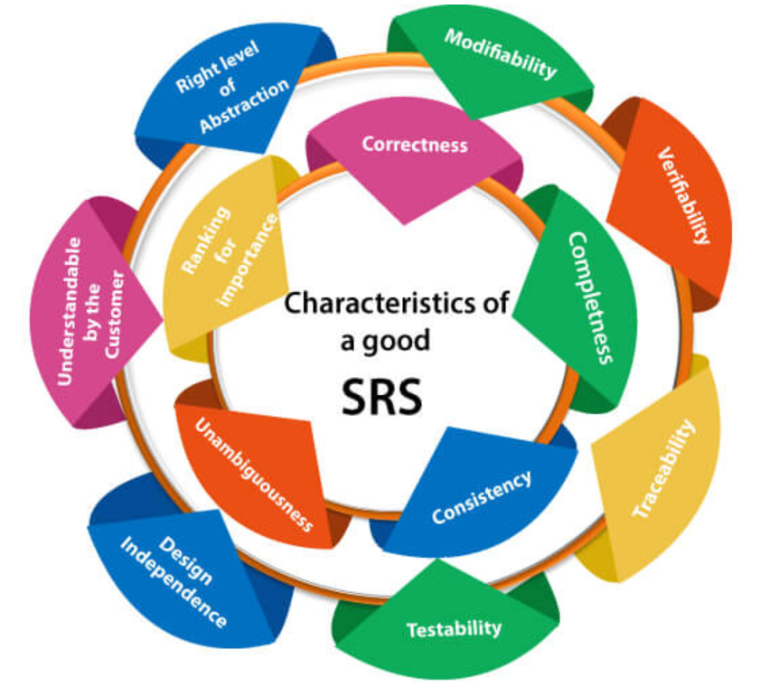
2.4 Software Requirement Specification (SRS)
While there's no "Perfect SRS," it should be:
Correct
Unambiguous
Complete (no TBD sections)
Verifiable
Consistent in behavior and terms
Understandable by customers
Modifiable
Design-independent
Concise
Organized
Traceable (each requirement can be referenced)

Slide 11
Software Requirements Specification (SRS) for Online Shopping Website
1. Introduction
The Online Shopping Website aims to provide a seamless shopping experience for customers. This document outlines the requirements for the system to ensure it meets the following criteria:
2. Characteristics of a "Perfect SRS"
Correct
The system shall accurately calculate the total price of items in the shopping cart.
2. Ambiguous
The terminology used in the SRS shall be consistent. For example, "shopping cart" shall not be referred to as "cart" elsewhere.
3. Complete (no TBD sections)
The SRS shall not contain any sections marked as "To Be Determined (TBD).“
4. Verifiable
The system shall generate an order confirmation email after a successful purchase.
5. Consistent in behavior and terms
The system shall use the term "add to cart" consistently across all interfaces and documentation.
6. Understandable by customers
The user interface shall be intuitive, with clear navigation and easily readable product descriptions.

Slide 12
Continue:
2.7 Modifiable
The SRS shall allow for future modifications to accommodate new payment methods without major system redesign.
2.8 Design-independent
The system shall not depend on a specific web design and shall function with different layouts and themes.
2.9 Concise
Requirements shall be written succinctly, avoiding unnecessary technical jargon.
2.10 Organized
The SRS shall be organized into clear sections for easy reference.
2.11 Traceable (each requirement can be referenced)
Each requirement shall be uniquely identified with a reference number, e.g., REQ-001.
3. Functional Requirements

Slide 13
Continue:
3.1 User Registration
The system shall allow users to create an account (REQ-001).
3.2 Product Catalog
The system shall display a list of products with images and descriptions (REQ-002).
3.3 Shopping Cart
Users shall be able to add and remove items from the shopping cart (REQ-003).
4. Non-Functional Requirements
4.1 Performance
The system shall load product pages in less than 2 seconds (REQ-004).
4.2 Security
User data shall be encrypted during transmission (REQ-005).

Slide 14

HEADINGS FOR SRS:
Introduction
Purpose of the document
Scope of the project
Overview of the software being described
Document Conventions
Explanation of any specific conventions or terminology used in the document
References
Any external documents or sources referenced in the SRS
Overall Description
Product perspective
Product functions
User classes and characteristics
Operating environment
Design and implementation constraints
Assumptions and dependencies

Slide 15
CONTINUE…
Specific Requirements
Functional requirements
Non-functional requirements (performance, security, usability, etc.)
External interfaces
System features
Data requirements
Use cases or scenarios
System Features
Detailed descriptions of each system feature or function
External Interface Requirements
Description of interfaces with external systems or components
Non-Functional Requirements
Performance requirements (response times, throughput, etc.)
Security requirements
Usability and user interface requirements
Reliability and availability requirements
Scalability and maintainability requirements
Legal and regulatory requirements

Slide 16
CONTINUE…
User Interface Requirements
Design and layout specifications
User interaction and navigation
Quality Attributes
Reliability
Availability
Scalability
Maintainability
Portability
Constraints
Any limitations or constraints affecting the project
Assumptions and Dependencies
Assumptions made during the requirements gathering process
Dependencies on external factors or systems
Appendices
Additional information or documentation that supports the SRS
Use case diagrams, data flow diagrams, etc.
Glossary
Definitions of technical terms or acronyms used in the document

Slide 17


Tools used for this lab:
Tools:
Microsoft Word: Microsoft Word is a versatile tool for creating documents, including Software Requirement Specification Documents. It provides templates and formatting options for professional documentation.
Project Management Software: Project management tool like Trello often have features for creating and managing project documentation, including Software Requirement Specification Documents.

Slide 18

Ms word:

Slide 19
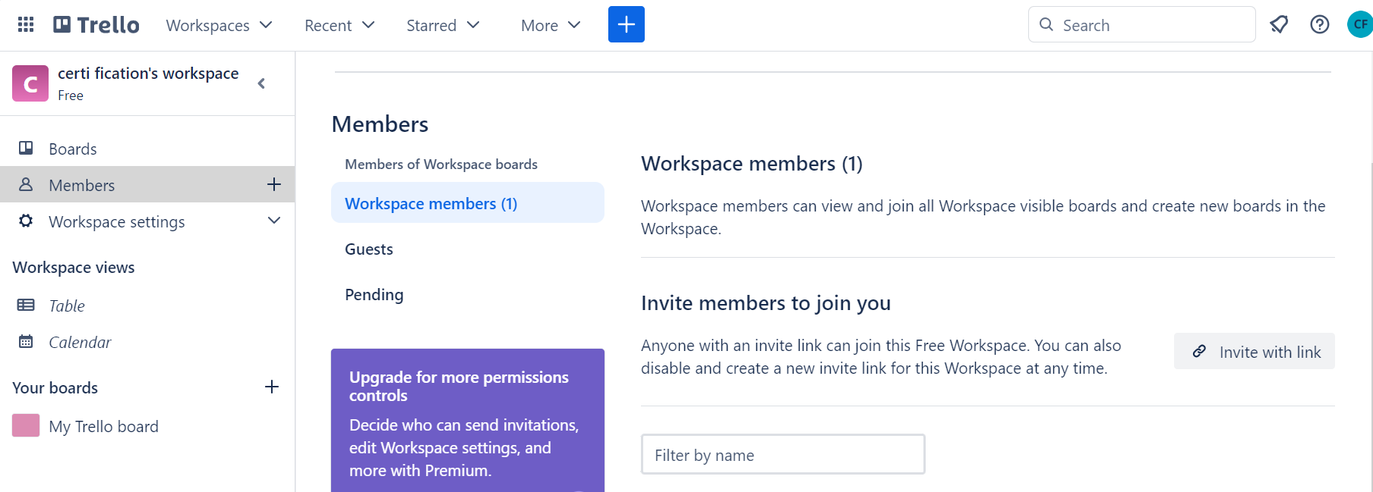
trello

Slide 20
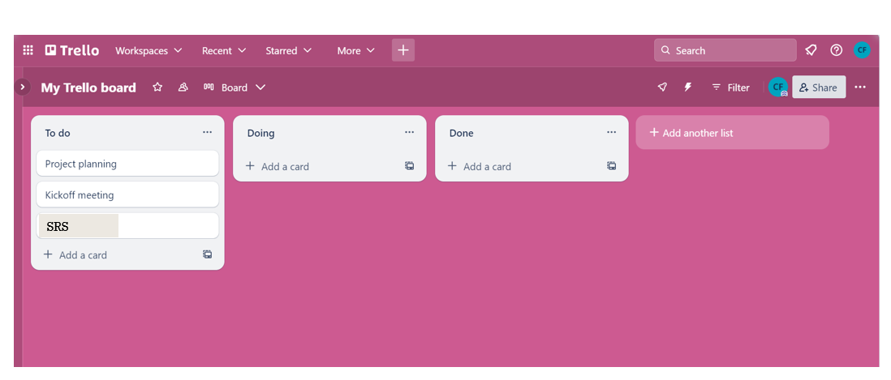
continue :

Slide 21
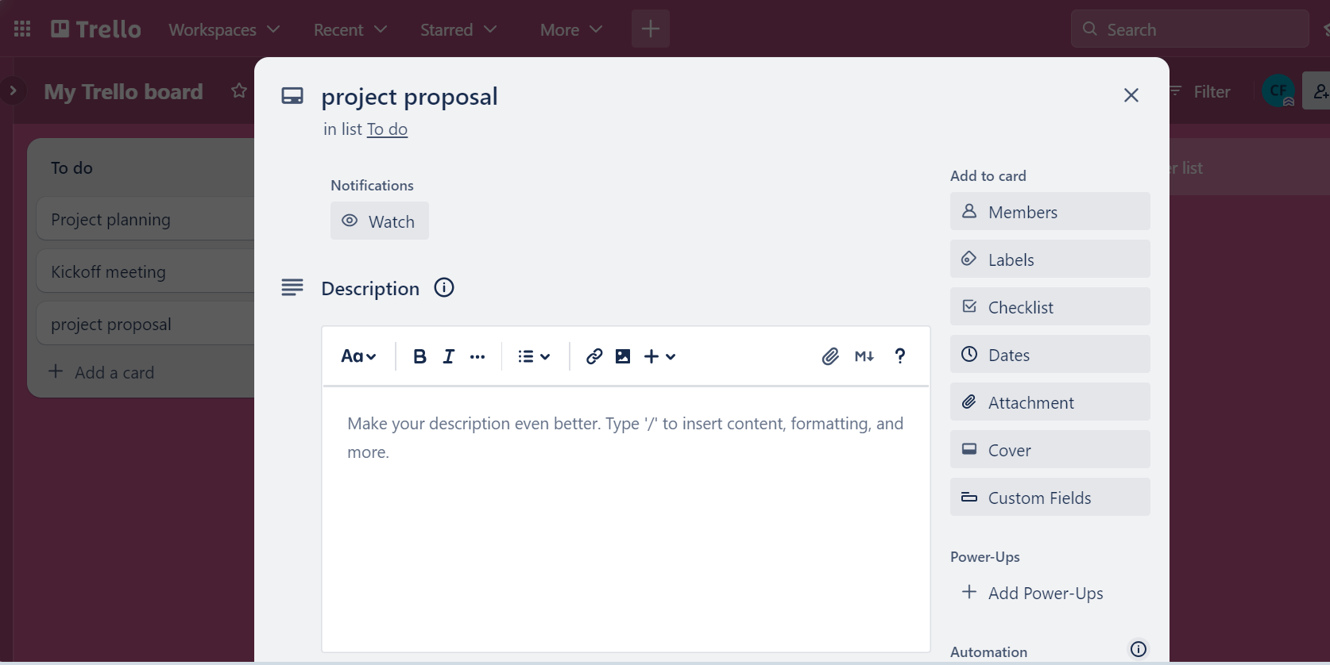
continue :
SRS

Slide 22
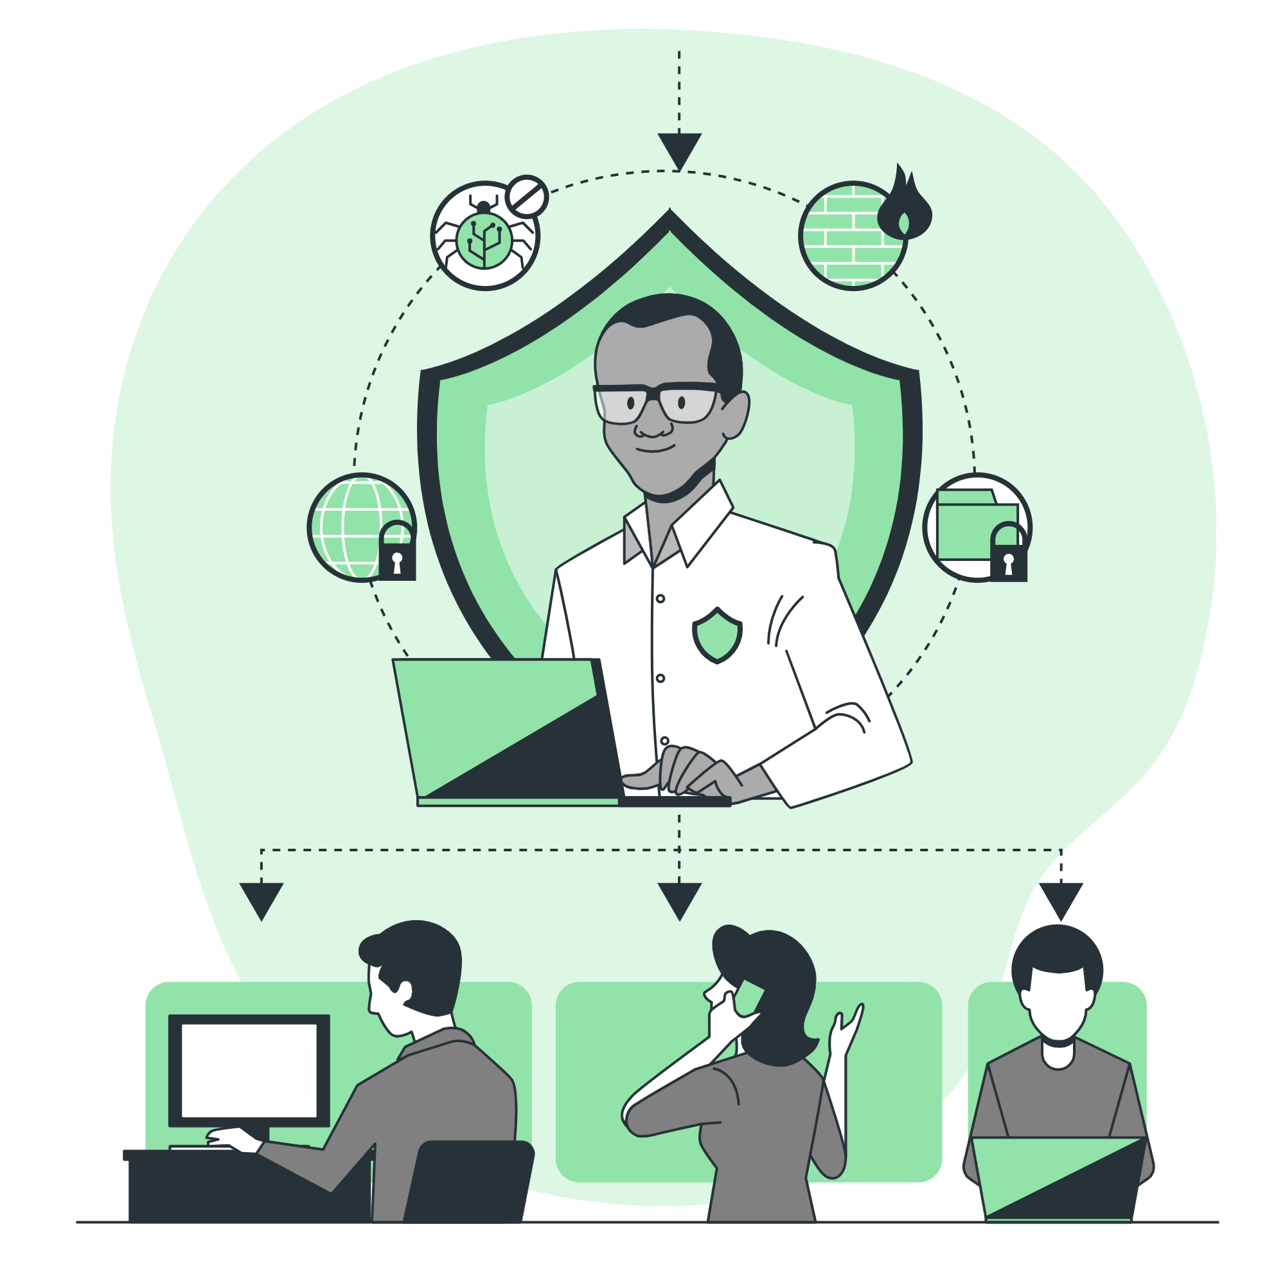
Tasks 1:
Write SRS for your project and submit it.
Document the SRS. Present it to the instructor. Once you have documented the Project’s SRS share it on Trello which is a project management collaboration tool with your team.

